Slide 1
Goretty Muñoz Martinez My life
Born in Los Mochis, Sinaloa, México
Lived throughout Mexico until I turned 16 years old.
Graduated High School in Anthony, New Mexico
Bilingual- Spanish/English
International Student at New Mexico State University
Junior at New Mexico State University

Slide 2
Aspirations in Higher Education
Pre-Business Associates (December 2009)
Bachelors degree in Finance, International Business and Spanish (December 2011)
Master in MBA from European University

Slide 3
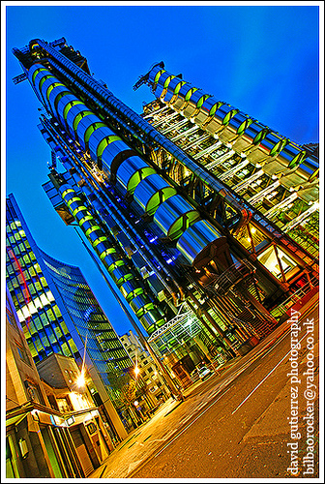
Future Expectations
Practice Financial Services
Become a CEO, director for a Company
Have my own business in Mexico and in the U.S.
World Affairs
Travel overseas
Don’t worry and be happy as much as possible

Slide 4
Personal Attributes
Thinker
Communicative
Introvert
Ambitious (I focus and work hard in order to obtain my goals)
Quiet and reserved (when it is necessary to be quiet and reserved, depending on the occasion)
I resolve my problems with patience, but first of all I analyze the situation.

Slide 5
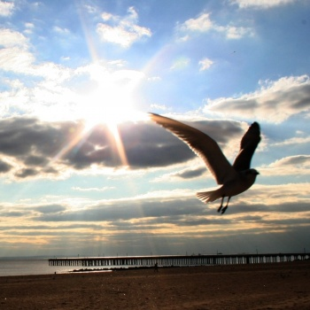
Visions
Strive for what I want
“In this life nothing is impossible”
Never regret what you have
Live your life as much as possible

Slide 6
Missions
I strive for a good education by studying and working hard
I will work hard to accomplish my goals surpassing any obstacles
Never regret what I have done
Live my life to the fullest

